Slide 1


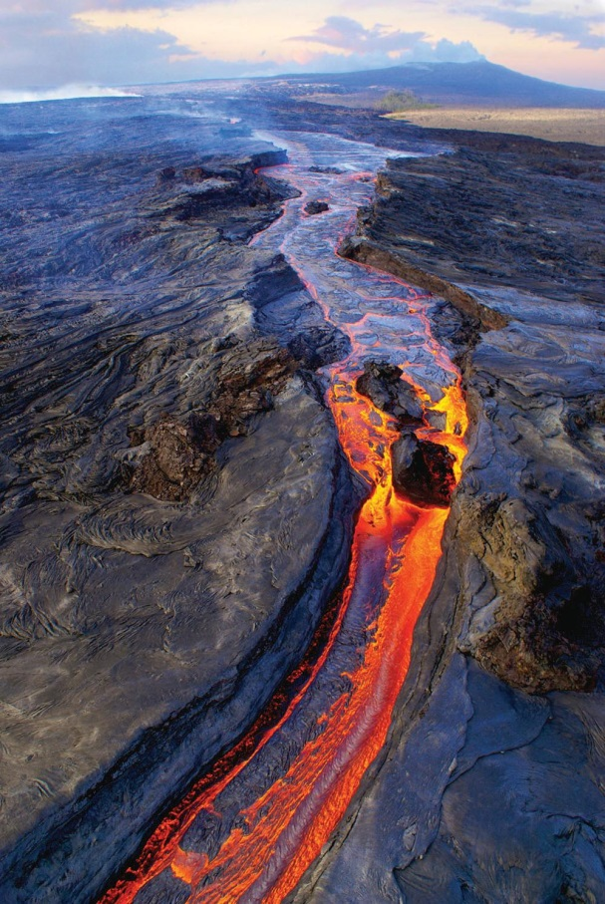
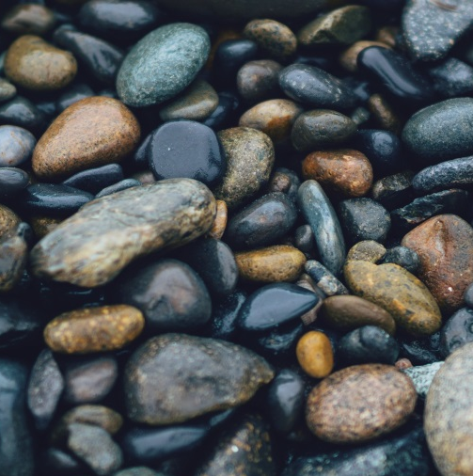
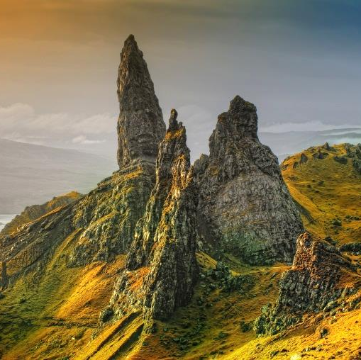
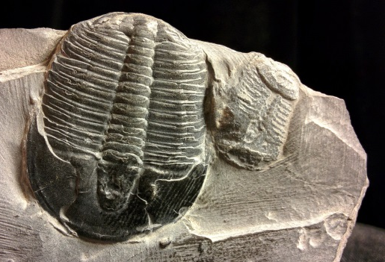
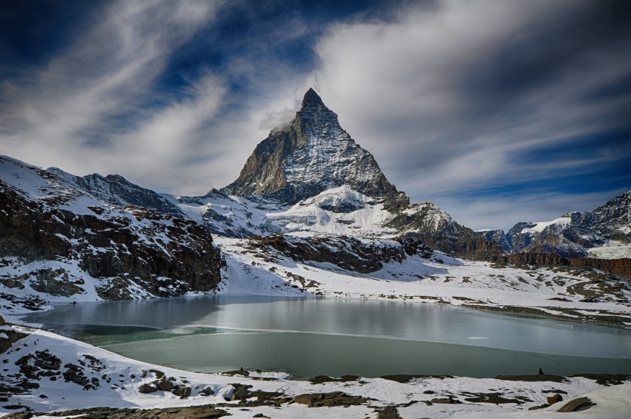
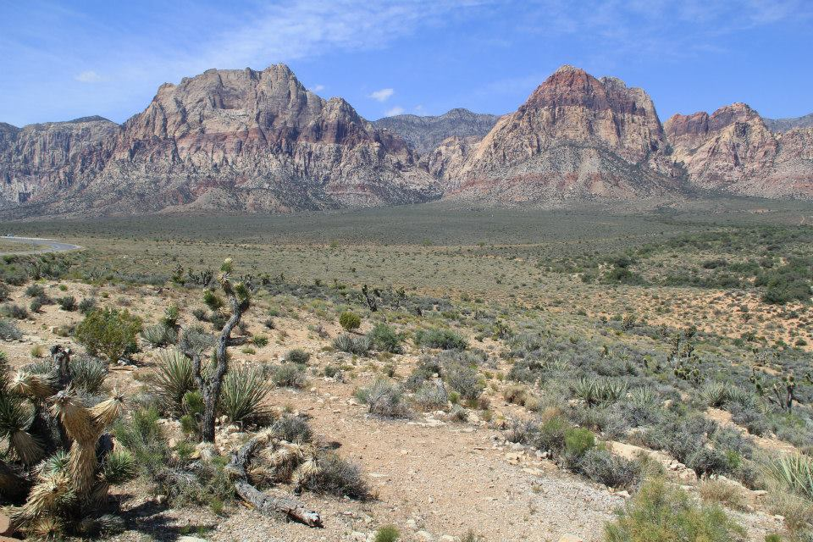
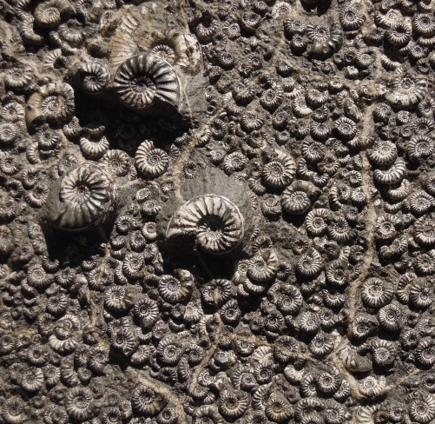
Notes:
Teacher and presenter guidance
This presentation is broken down into 5 main sections with a quiz activity at the end. Each slide has some suggested guidance in the notes section on how to explain the slide.
Suggested questions to ask are highlighted in bold.
The Geological Society gives permission for individuals to adapt the presentation however they see fit.
What is a rock?
What is a rock (1) – structure of the Earth
What is a rock (2) – elements and minerals
2. Igneous rocks
Extrusive rocks (1) – rocks formed from lava
Extrusive rocks (2) – rocks formed from ash
Intrusive rocks – rocks formed from magma
3. Sedimentary Rocks
Weathering and erosion
How sedimentary rocks are formed
Different environments
Porous & Permeable
Fossils
4. Metamorphic rocks
- How do metamorphic rocks form
Types of metamorphic rock
The rock cycle
5. Uses of rocks
Quiz

Slide 2

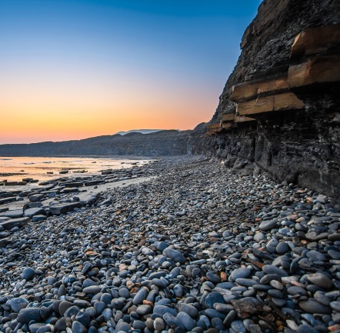

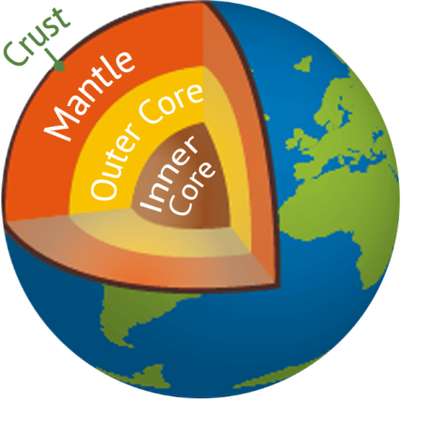
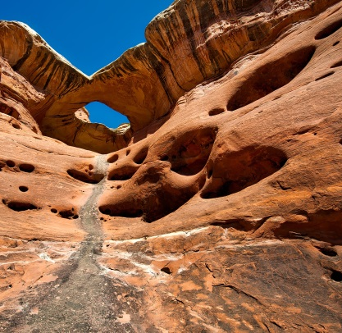
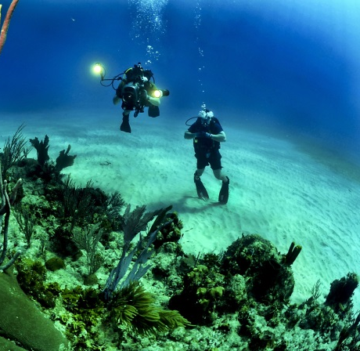
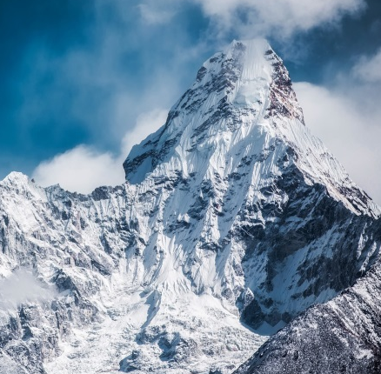
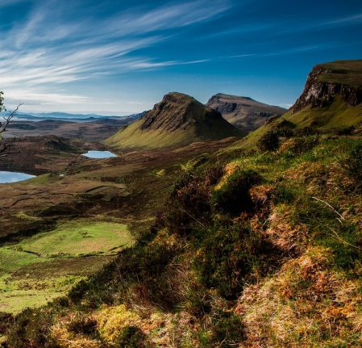
Notes:
What is a rock?
Before we can answer this question we need to know about the structure of the Earth.
What do you think is inside the Earth?
The Earth is made up of four layers: the inner core, the outer core, the mantle and the crust.
The inner core is a huge solid ball of iron and nickel metal in the centre of the Earth. How hot do you think the centre of the Earth is?
The inner core is 6000°C. On land these temperatures would be enough to melt metal but because of the immense pressure of all of the other layers above it, the inner core stays completely solid.
The outer core is a thick layer of liquid metal with similar temperatures to the inner core. The outer core flows around the inner core and this is what gives the Earth it’s magnetic field. The magnetic field helps protect the Earth from harmful radiation from the sun and space.
The mantle is a thick layer of solid and partly molten rock it is still extremely hot with temperatures between 500 and 4000°C.
The crust is thinnest layer outmost layer of the Earth and is made entirely from rock. All of the mountains, volcanoes, ocean floors, valleys, canyons, hills and cliffs are part of the Earth’s crust and they are all made from different types of rock.
Wherever you are on Earth there will always be rock beneath your feet.
Can anyone name some different types of rock?

Slide 3

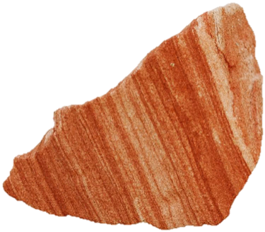

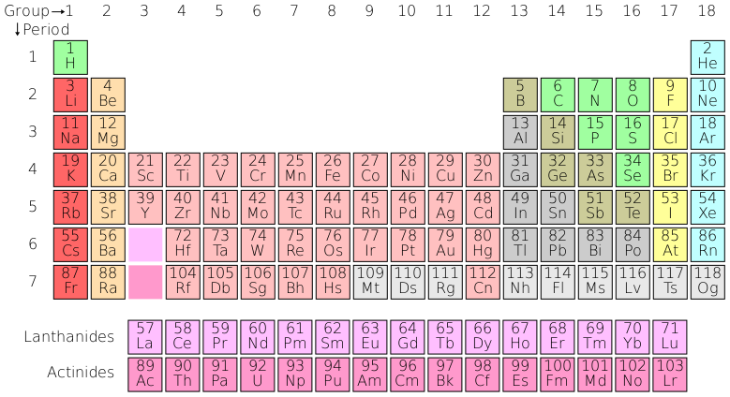
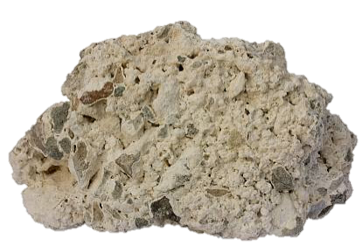
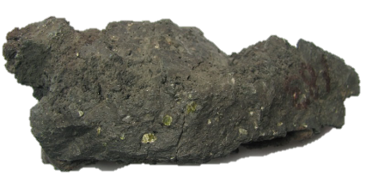
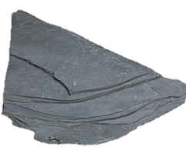
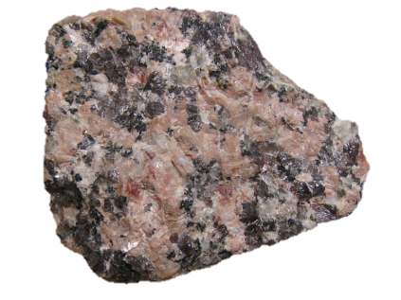
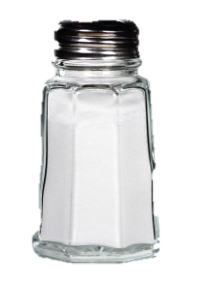
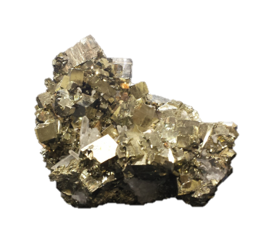
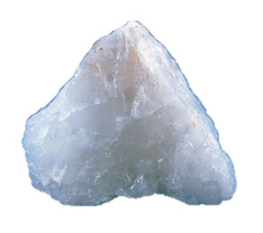
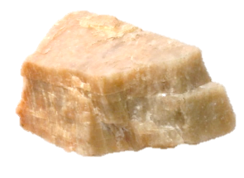
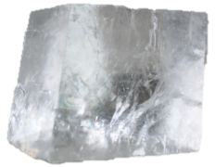
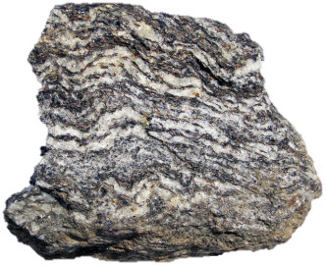

Sandstone
Limestone
Basalt
Sandatlas.org
© 2013 Imperial College London
Sandatlas.org
Granite
Slate
Feldspar
© Barry Marsh SOES
Pyrite
Quartz
© 2013 Imperial College London
Sandatlas.org
Halite (salt)
Gneiss
Calcite
Flickr/James St John
Notes:
What is a rock?
To understand rocks you first have to understand minerals.
Minerals are naturally occurring chemical compounds made up of elements.
What is an element?
Elements, such as oxygen, silicon, iron and aluminium can be seen in the periodic table. Elements are arranged in a particular structure which is unique for each mineral. Because of the different structures and combinations of elements, each mineral has different properties such as shape, colour, hardness and weight.
There are over 5000 known minerals on Earth, and scientists, called mineralogists, are continuing to discover new minerals every year.
Some common minerals include salt (known by geologists as halite) – made up of sodium and chlorine atoms (NaCl), quartz made up of silicon and oxygen atoms (SiO₂), pyrite made from iron and sulfur atoms (FeS₂) and calcite made from calcium, carbon and oxygen atoms (CaCO₃).

Slide 4
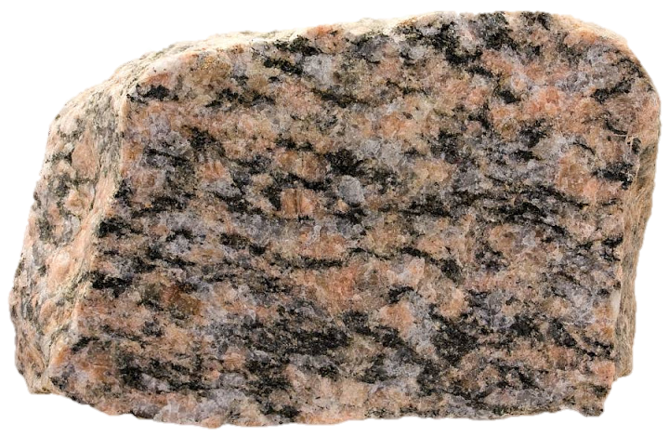
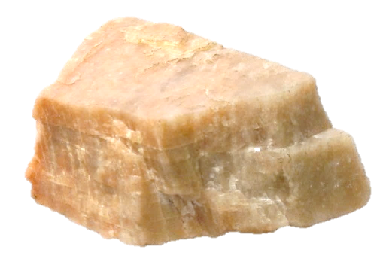
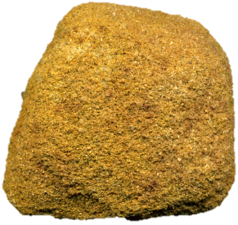
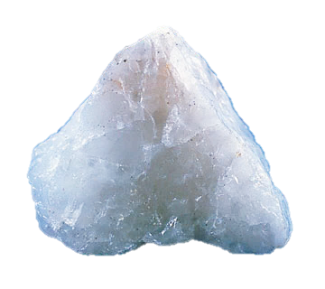
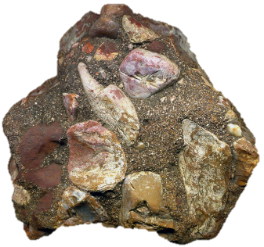
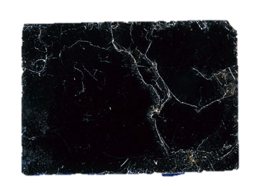
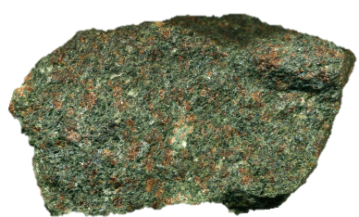
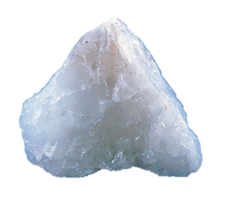

WHAT IS A ROCK?
Feldspar (Image:© Barry Marsh SOES )
ROCKS
Sandstone
ELEMENTS
Conglomerate
Quartz
Basalt
Flickr/James St John
© 2013 Imperial College London
Flickr/James St John
Eclogite
Granite
Sandatlas.org
Pyrite
Quartz
© 2013 Imperial College London
Flickr/James St John
Biotite
Calcite
Halite (salt)
MINERALS
Gneiss
Flickr/James St John
Notes:
All rocks are made from a mixture of minerals. For example the rock granite is made from a mixture of the minerals: quartz, feldspar and biotite.
(If you have a granite sample, hand it round with a hand lens so students can see the different minerals)
Some rocks, like granite, are made from interlocking mineral crystals that fit tightly together. Other rocks like sandstone and conglomerates are made up from broken fragments, or grains, of older rocks and minerals which have been cemented together.
There are three main types of rock which are formed in different ways on Earth.
Does anyone know what these different types of rock are called?
These are known as igneous, sedimentary and metamorphic rocks.

Slide 5

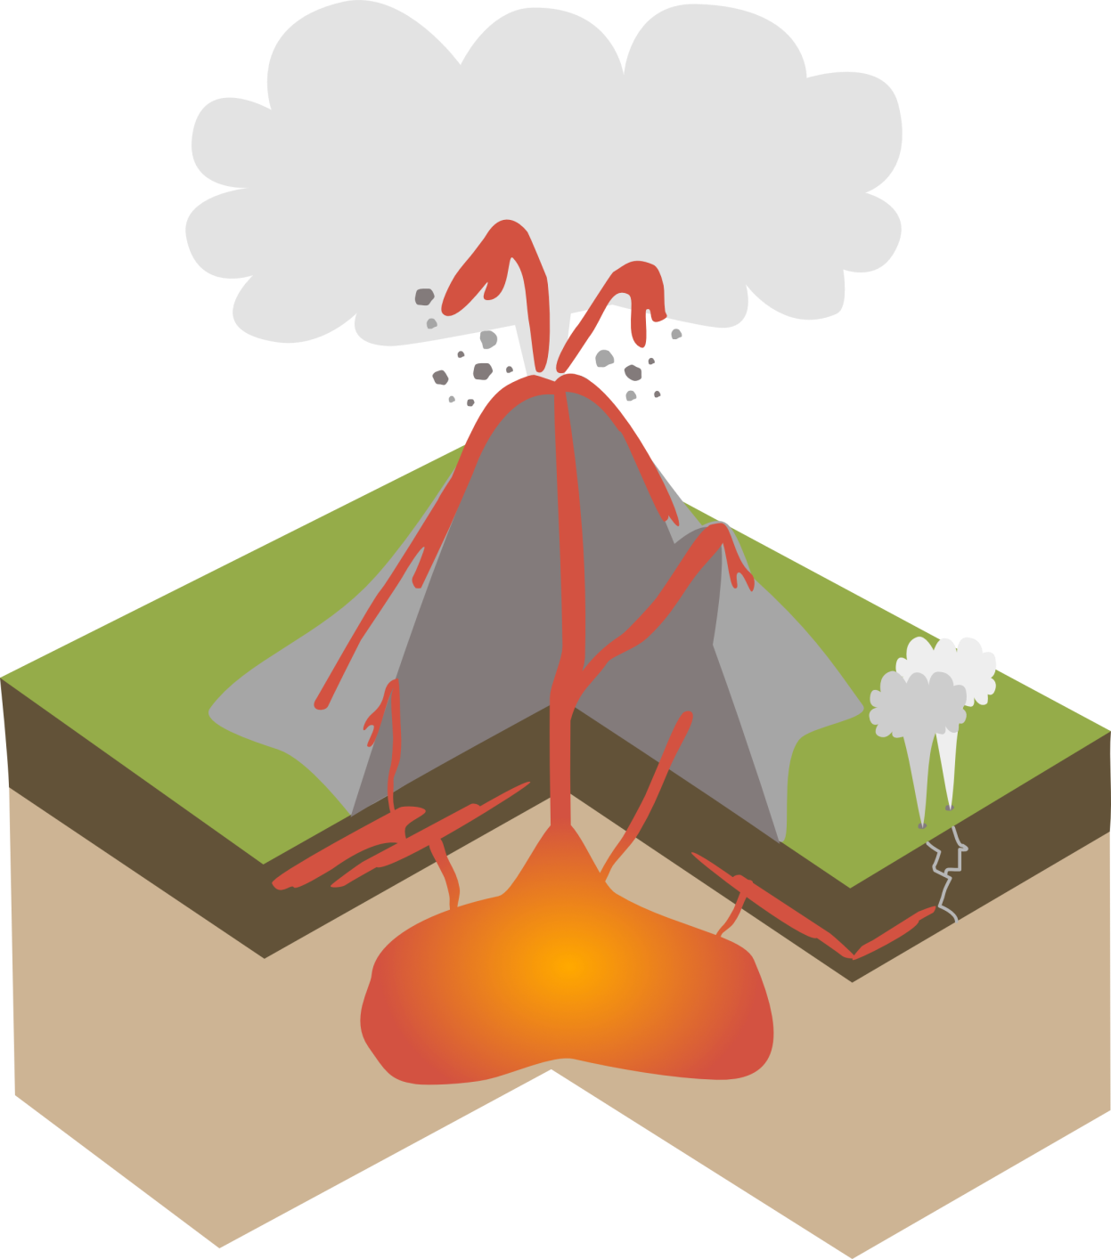
VOLCANO
LAVA
- above the surface
MAGMA
- below the surface
Notes:
Igneous rocks are made from molten rock.
Below the surface of the Earth, molten rock is called magma but when erupted above the ground, usually through volcanoes, it is called lava.
Igneous rocks form when either magma or lava cools down and turns from liquid to solid. When this happens, igneous rocks form crystals and are said to crystallise.

Slide 6


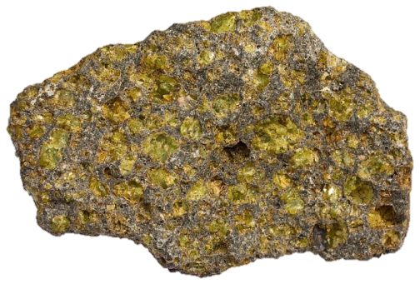
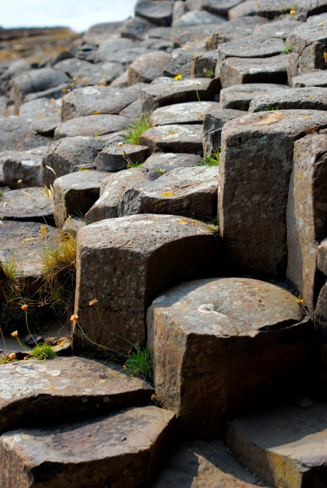
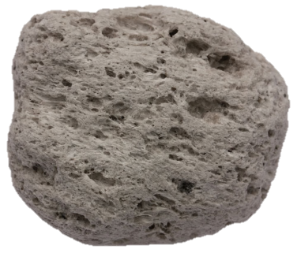
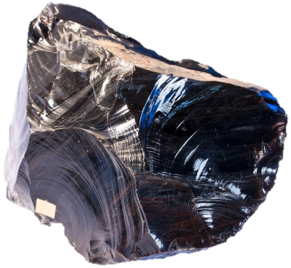

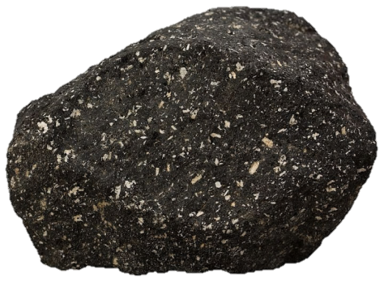
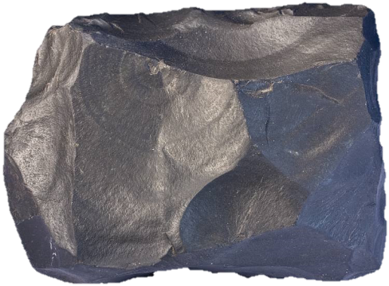
Basalt columns, Isle of Mull
Pumice
Obsidian
Magma
Basalt with olivine crystals
Andesite
Basalt
Rock images: Sandatlas.org
Notes:
Rocks formed from lava are known as extrusive igneous rocks.
Lava cools down very quickly once it has been erupted because the surface of the Earth is much colder than hot lava which can be between 800-1100°C when erupted. This means that igneous rocks formed from cooling lava, such as basalt, only have time to grow tiny crystals which usually only be seen under the microscope. Obsidian, or volcanic glass, cools so quickly that you cannot see any crystals at all.
Sometimes we find larger crystals of a green mineral called olivine in extrusive igneous rocks such as basalt. These crystals do not form as the lava is cooling down but form before the lava is erupted whilst the magma is still inside the magma chamber.
Magma and lava can contain a lot of dissolved gas. Because extrusive igneous rocks cool down so quickly, gas bubbles from cooling lava can often get trapped in the structure of the rock. Pumice is a rock with so many gas bubbles trapped inside that it can actually float on water!
(If you have a sample of pumice you could demonstrate this)

Slide 7

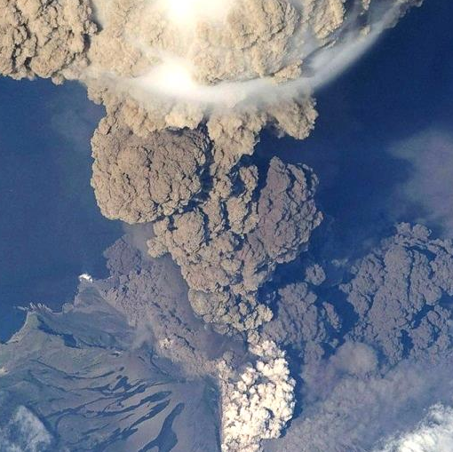
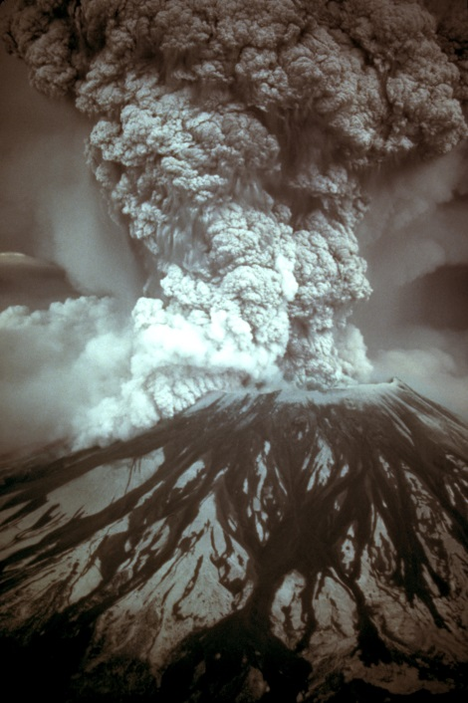
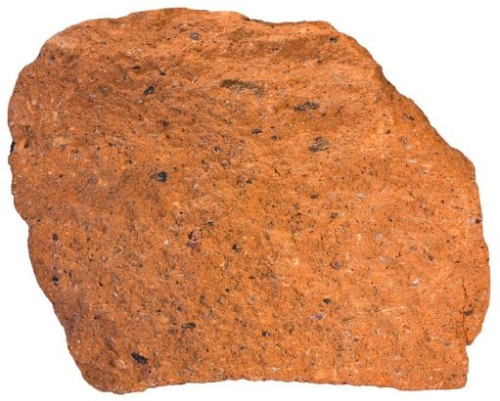

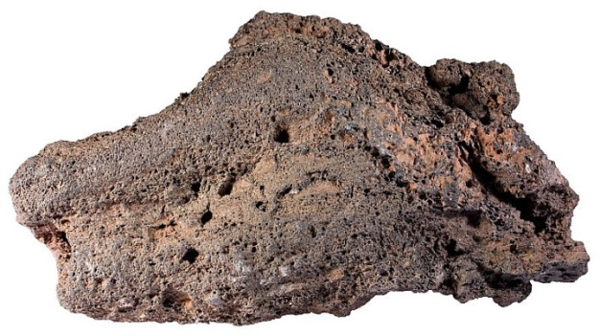
ASH
Tuff
Magma
Volcanic bomb
Rock images: Sandatlas.org
Notes:
Different types of volcanoes can erupt in different ways. Sometimes volcanoes erupt more explosively and giant ash clouds are erupted rather the more gentle flowing river of lava. Extrusive igneous rocks can form from these explosive eruptions too.
Volcanic tuff is a type of igneous rock, formed from material thrown out during an explosive volcanic eruption. In these eruptions, fragments of rock and ash are blasted from the volcano, propelled through the air and then deposited in the surrounding area. They are then compacted and cemented into a rock. This can be instant if the material is still hot.
Volcanic bombs are chunks of rock that were molten when they were erupted but cool down and solidify as they fly through the air. Volcanic bombs can be thrown hundreds of metres away from the volcano.

Slide 8
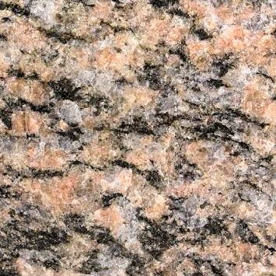

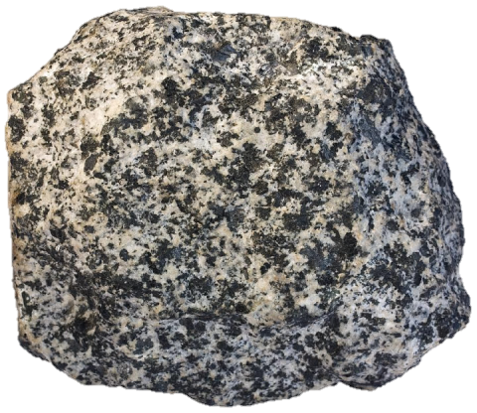
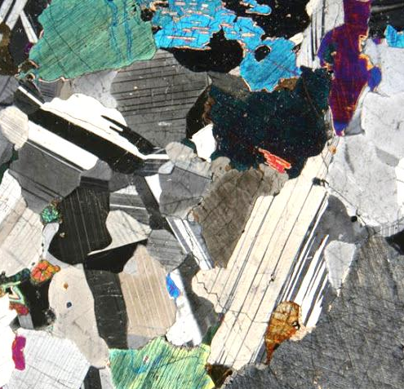

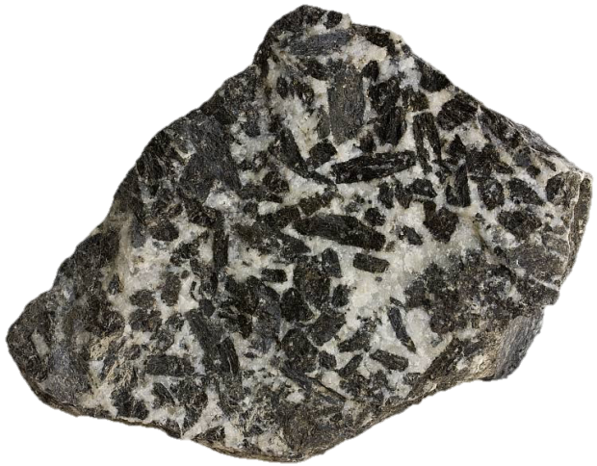
Gabbro under the microscope
Diorite
Granite
MAGMA
Gabbro
Rock images: Sandatlas.org
Notes:
Rocks formed from magma below the Earth’s surface are known as intrusive igneous rocks.
Magma deep within the Earth takes thousands of years to crystallise because temperatures increase as you go deeper into the Earth. Because the magma takes longer to cool down, the crystals forming from the magma have more time to grow. Most intrusive igneous rocks therefore have large well-formed crystals.
If you look closely at an igneous rock that has formed deep within the Earth, for example granite or gabbro, you will be able to see the different coloured minerals crystals just with your eyes.
If you look under the microscope you can also see clearly how the crystals have grown to interlock with each other (note: these are not the real colours of the crystals but looking at rocks in this way helps geologists to identify different minerals).

Slide 9

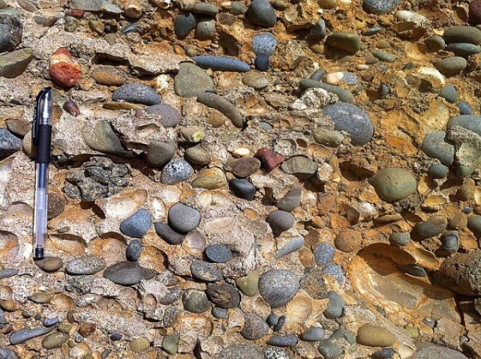
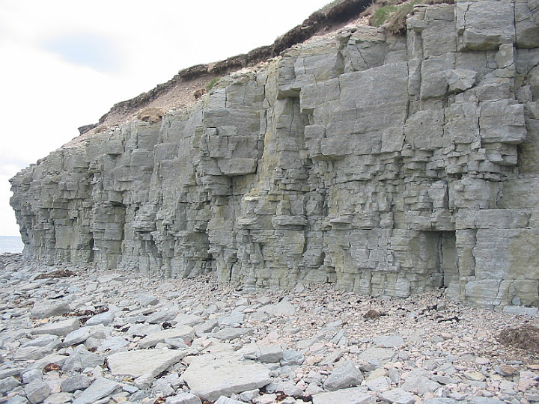





Conglomerate
Shale
Limestone
Sandstone
Rock images: Sandatlas.org
Notes:
Here are some examples of sedimentary rocks. What do you notice about these rocks? (colours, layers, made from grains, contain fossils etc.)
(1. Limestone cliffs, 2. limestone with crinoid (sea lily) fossils, 3. Shale – rock made from mud composed of tiny silt/clay sized grains (much smaller than sand) 4. Conglomerate – rock made up of rounded pebbles 5. sandstone, 6. layered sandstone 7. sandstone in Antelope Canyon Arizona)
Sedimentary rocks are made from grains and minerals of older rocks which have been cemented together. Grains can be large like the pebbles in the conglomerate, sand sized like in the sandstones, or tiny particles like in the shale. Grains can be from older rocks or can be from fossils like in the limestone.
For sedimentary rock to form, rocks on the Earth’s surface first need to be broken down into smaller fragments and this happens through the process of weathering.

Slide 10











Boulders
Pebbles
Magma
Sand
WEATHERING - The breakdown and decay of rock by natural processes (physical, biological and chemical)
EROSION - The action of water or ice wearing away rocks
Notes:
Rocks on the Earth’s surface are constantly being broken down into smaller pieces or fragments by weathering and erosion. This happens over the course of hundreds, thousands and even millions of years.
How do you think rocks can be broken down into smaller fragments?
Weathering can happen in a few different ways. Here are some examples:
Chemical weathering: acid in rain can breakdown soluble minerals in the rocks.
Physical weathering: In cold mountainous environments ice can cause weathering. Here, water can get into cracks and cavities in rocks and then freeze if its cold enough. When water freezes it expands and puts pressure on the surrounding rock which will eventually break up.
Physical weathering: Rocks expand when heated and contract when cooled. When this happens repeatedly it will eventually cause rocks to crack and parts will break away. This type of weathering happens a lot in deserts, because it is very hot during the day but very cold at night.
Biological weathering: Plant roots and burrowing animals like rabbits and badgers can also break down rock into smaller pieces.
Examples of erosion include:
Glaciers can crush rocks into smaller fragments as they flow over them.
Waves at the coast force air into cracks in cliffs causing them to expand, breaking the rocks apart (hydraulic action)
Large boulders can be gradually weathered and eroded into pebbles and eventually into tiny grains.
Broken up pieces of rock are called sediment and can be transported away by rivers, glaciers and wind.

Slide 11




Eroded material is transported by rivers, glaciers and wind
Sediment settles into layers
Grand Canyon, Arizona
Layers in sandstone
Sediment is compacted and cemented into SEDIMENTARY ROCK
sandatlas.org
Notes:
After they have been transported by rivers, glaciers and by wind. Sediments often collect at the bottom of lakes, oceans, estuaries, lagoons, river beds, in sand dunes and more.
Over time (thousands and millions of years) rocks continue to be weathered and eroded at the surface and layers and layers of sediment gradually build up.
What do you think happens to the sediment as it builds up?
The individual sediment fragments become compacted and cemented together to become a sedimentary rock.
Sedimentary rocks are laid down in layers known as beds or strata. You can see these layers in cliff faces, and at a smaller scale in individual rocks.

Slide 12







WHERE ARE SEDIMENTARY ROCKS FORMED?
Coral reefs
River delta
Desert sand dunes
Coastal sand dunes
Beach & shallow sea
River beds & banks
Glacial moraine
Notes:
There are many different types of sedimentary rock because sediment can be deposited in many different environments.
What different environments can you see here? (click and environment names will pop up)
These include desert sand dunes, river deltas, coral reefs, river beds and banks, coastal sand dunes, beaches, shallow and deep sea and near glaciers.

Slide 13




ENVIRONMENTS
Image: Wikimedia/PLOS Biology
Image: Wikimedia/Ian Stannard
Coral reefs
Microscopic plankton (coccolithophore)
River delta
Desert sand dunes
Coastal sand dunes
Chalk cliffs
Beach & shallow sea
Bloom of plankton
River beds & banks
Glacial moraine
Notes:
Geologists can study sedimentary rocks to learn about past environments on Earth.
For example the sedimentary rock chalk is formed in shallow, warm seas forms from the microscopic shells of marine plankton called coccolithophores. Millions of these plankton bloom in the ocean (enough to be seen from satellite images) and then they sink to the ocean floor when they die. As the sediments build up and are buried they turn into chalk.
Chalk that formed 65-100 million years ago is found on the south coast of England in the Isle of Wight and Dover. This means that during this time (called the Cretaceous period) these areas must have been covered by warm, shallow seas.

Slide 14


IMPERMEABLE – not enough space for water
POROUS - Lots of pore spaces
Few small pore spaces
PERMEABLE - water can be absorbed
Notes:
Sedimentary rocks are made up of grains from older rocks cemented together. The grains can be different shapes and sizes and from tiny microscopic grains up to the size of large boulders.
Under the microscope we can sometimes see gaps between the different grains – these gaps are called pores. If a rock has lots of pores it is a very porous rock and if it has no pores (or very few) it is non-porous. Rocks with rounded grains are more likely to be porous.
A porous rock can also be permeable. This means that water can be absorbed into the gaps between the grains. Non-porous rocks are impermeable because there is no space for water to be absorbed.
If you put a permeable rock in water you will see bubbles of air being pushed out of the rock as the water is absorbed into the pores.
Why do you think its important to know which rocks are permeable and which rocks aren't?
(you wouldn’t want buildings to absorb lots of water, sediments that are porous might contain crude oil)

Slide 15













Notes:
Sedimentary rocks can also contain fossils from plants and animals.
How do fossils form?
There are a few different ways fossils can form. Animals and plants can get trapped in amber like the mosquito from Jurassic Park, however this is very rare. The most common way that fossils are formed is when they are buried quickly by soft sediment in a calm watery environment like at the bottom of a lake, an estuary (where the river meets the sea) or on the ocean floor.
This diagram shows simply how a fossil of a plesiosaur, a marine reptile from the Jurassic period, might form.
Stage 1: The animal dies and falls to the bottom of the sea or lake.
Stage 2: A landslide occurs nearby and the plesiosaur is buried quickly in mud, preventing scavenging animals from gobbling it up.
Stage 3:The muscles, skin and other soft parts of the plesiosaur are digested by bacteria in the sediments. Only the hardest parts such as the bones and teeth are left.
Stage 4:As time passes, more and more sediment builds up .The weight of the overlying layers squashes the soft mud and it begins to turns into rock. This is called lithification. Water is squeezed out of the mud and seeps into the plesiosaur bones. Minerals and chemicals in this water gradually change the bones and teeth into stone. The plesiosaur is now a fossil but it is buried under layers and layers of rock under the ocean.
Stage 5:Over millions of years, huge sections of the Earth’s crust called tectonic plates move around on top of the mantle a bit life rafts floating on thick syrup. Continents can crash into each other and shove the rocks upwards. Rocks that were previously at the bottom of the ocean can be forced onto land!
Stage 6: Over time the rock layers are gradually stripped away by erosion (wind, rain, waves and ice). Part of the fossil is revealed at the surface to be discovered by a lucky fossil hunter!
Does anyone know the names of any fossil animals or plants? (might know some dinosaurs names, ammonites, trilobites etc.)

Slide 16





HOW DO FOSSILS FORM?
1: DEATH
2: BURIAL
Fern
3: DECAY OF SOFT PARTS
Ammonite
Triceratops skull
Trilobite
4: SEDIMENTATION & FOSSILISATION
5: UPLIFT ONTO LAND
6: EROSION & EXPOSURE
Microfossils
(foraminifera)
Notes:
Some different types of fossils.

Slide 17






Igneous rock
(Granite)
Metamorphic rock
(Gneiss)
Rock images: Sandatlas.org
Notes:
Metamorphic rocks are rocks that have been changed over time. When rocks are pushed deep down into the Earth for example underneath a mountain belt like the Alps or the Himalayas, grains and minerals can become stretched, squashed and slightly melted from the extreme pressure and heat. This is called metamorphism and it causes new metamorphic rocks with different textures and/or minerals to form.
Metamorphic rocks are crystalline like igneous rocks but can have banded textures.
When the igneous rock granite is put under lots of heat and pressure it turns into the metamorphic rock gneiss.
Can anyone remember the names of the minerals we looked at in the granite? (pink = feldspar, milky white = quartz, black/dark brown = biotite)
The minerals in gneiss are essentially the same as the granite but the rock has a different structure because the minerals have aligned into layers black layer = biotite pink/white layers = quartz & feldspar

Slide 18


Notes:
How do metamorphic rocks form?
The crust is broken up into pieces called tectonic plates which move around on top of the mantle like rafts floating on thick syrup. Tectonic plates move at a rate of a few millimetres per year, but over millions of years they can move thousands of kilometres.
The meeting points between tectonic plates are called plate boundaries and this is where most volcanoes and earthquakes on Earth occur. At plate boundaries plates can either move away, towards or alongside each other.

Slide 19




Notes:
How do metamorphic rocks form?
When plates are move towards each other over millions of years they can either squeeze upwards to form mountains or be forced down into the mantle.
Metamorphic rocks can form here. As the plates push more and more towards each other, pressures build up.
What would happen if you had some playdough between your two palms and then pushed them together as hard as you could?
The play dough would be completely flattened because of the pressure put on it.
At these locations rocks can also be forced downwards which increases pressures and temperatures. If you took a fresh bit of playdough and put it under one sheet of paper it would not deform. However if you put it under a stack of 100 sheets of paper it would get squashed flat. The weight of the overlying rock has this effect – rocks near the surface are not under a lot of pressure but as you go deeper into the Earth, the weight of the rock squashes and squeezes the rocks.

Slide 20




Gneiss
Slate
Marble
Schist
Rock images: Sandatlas.org
Notes:
The metamorphic rock you end up with depends on 1: the type of rock you start with, and 2: the amount of heat and pressure the rock is put under.
Types of metamorphic rock
Slate – Slate is made up microscopic crystals arranged into fine layers of that can be split into thin sheets. Slate is most often formed from shale or mudstone that has been metamorphosed.
Schist – schists are a bit like slate but the mineral crystals are larger. This schist is made from a shiny mineral called mica and a dark red mineral called garnet. If hammered schists will split into layers. Schists are one of the most common rock types found in the continental crust.
Gneiss (pronounced ‘nice’)– gneiss is a rock that forms deep below mountain ranges. It often has bands of different minerals, in this example the darker bands are made from the mineral biotite and the lighter bands are made from the pink mineral feldspar and the white cloudy mineral quartz. Gneiss can be formed from igneous rocks like granite but can also be formed when sedimentary rocks are put under extremely high pressures and temperatures. If hammered gneiss will not split into layers.
Marble – marble is limestone that has been metamorphosed. Marbles can be pure white but often contain other coloured minerals.

Slide 21


Notes:
No rock stays the same forever. Over thousands and millions of years rocks are broken down, moved around and deposited in different places. Rocks can be compact together and pushed deep into the Earth where they are melted or deformed by intense pressure only to be uplifted again to the surface. All of these processes combine to make the rock cycle.

Slide 22











Notes:
What do we use rocks for? (blank screen)
(Click for examples to appear)
Rocks such as granite, limestone and sandstone are strong but easy to cut so they are often used as buildings stones.
Slate is used for roof tiles and black boards because it is hard, waterproof and it splits into fine layers
Graphite is a soft mineral found in metamorphic rocks. It is used in pencils and is very important for manufacturing steel.
We use special clays called china clay and ball clay to make crockery. The clays are formed when one of the minerals in granite, crumbles and rots. So we find the clays in areas where there are granites, such as Devon and Cornwall.
Coal is a sedimentary rock that can be burnt for energy. Coal found in Britain was formed from plants that grew in swamps about 300 million years ago – these plants became buried under sand and mud and gradually changed into coal.
All metals come from rocks including iron, copper and aluminium. Rocks with high concentrations of metals are called ores.
There are 62 elements needed to make a smart phone. All of these elements come from rocks.
Plastic is made from a brown sticky liquid called crude oil which comes from sedimentary rocks. All of the crude oil began as microscopic animals and plants called plankton. When the plankton died they fell to the bottom of the sea and over time became trapped in layers of mud and sand. Over millions of years the mud and sand turned into sedimentary rock. As these rocks were pushed deeper and deeper the increasing pressure and heat caused the plankton to break down and turn into oil. We can take crude oil of the ground by sinking boreholes to find it. In Britain, we get much of our oil from boreholes sunk into the floor of the North Sea.
Glass is made from a special sand made up of pure quartz grains mixed with limestone and other chemicals which are added to give the glass its colour, strength and brightness.

Slide 23

Notes:
Additional activity – 10 questions long
Get children into mixed ability teams –each team will need a pencil and paper – answers will be either A, B, C or D
Winning team could be given a small prize (badge, pen etc.)

Slide 24

What type of rock is sandstone?
A: Igneous
B: Metamorphic
C: Sedimentary
Rock images: Sandatlas.org
Notes:
Answer: C

Slide 25
QUESTION 2:
If limestone is put under pressure and heat it can turn into…
A: Marble
B: Sandstone
C: Basalt
Rock images: Sandatlas.org
Notes:
Answer: A

Slide 26


Which of these is an igneous rock?
A: Mudstone
B: Slate
C: Obsidian
Notes:
Answer: C

Slide 27

Which of these processes is NOT a type of erosion?
A: Lava erupting from a volcano
B: Waves crashing into rocks and breaking
them up into smaller fragments (hydraulic action)
C: Glaciers crushing rocks into smaller pieces
Notes:
Answer: A

Slide 28

Which of these rock types does not have interlocking crystals?
A: Metamorphic
B: Sedimentary
C: Igneous
Notes:
Answer: B

Slide 29

Which of these rocks can form from FAST cooling LAVA?
A: Granite
B: Basalt
C: Marble
Notes:
Answer: B

Slide 30

Which of these rocks can form from SLOW cooling MAGMA?
A: Granite
B: Basalt
C: Marble
Rock images: Sandatlas.org
Notes:
Answer: A

Slide 31



METAMORPHIC rocks are rocks that have been changed by…
A: Melting
B: Heat and Pressure
C: Erosion
Rock images: Sandatlas.org
Notes:
Answer: B

Slide 32

Chalk is made from…
A: Lava
B: Grains of sand
C: The shells of
microscopic plankton
Image: Wikimedia/Ian Stannard
Notes:
Answer: C

Slide 33

Which type of rock can contain fossils?
A: Metamorphic
B: Igneous
C: Sedimentary
Notes:
Answer: C

